Slide 1

American Air Quality Status and Trends Through 2020
Introduction to Data Visualization (1001)
Group 9
Laurel 1930026068
Justin 1930026081
Joanna 1930026083

Slide 2



Content
Motivation
American Pollutants air
Growth Areas and Emissions
Impacts From The COVID-19 Restrictions
Conclusion
Demo

Slide 3

01
Explore ways to solve the problems of Air Quality and Pollution
MOTIVATION
02
The U.S. Environmental Protection Agency (EPA) has Data Record for air pollution.

Slide 4
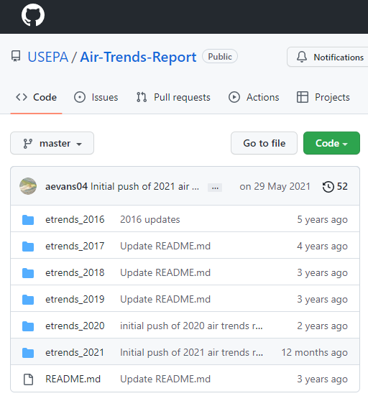
Dataset
Our dataset is from GitHub of USEPA, Air-Trends-Report, etrends_2021

Slide 5

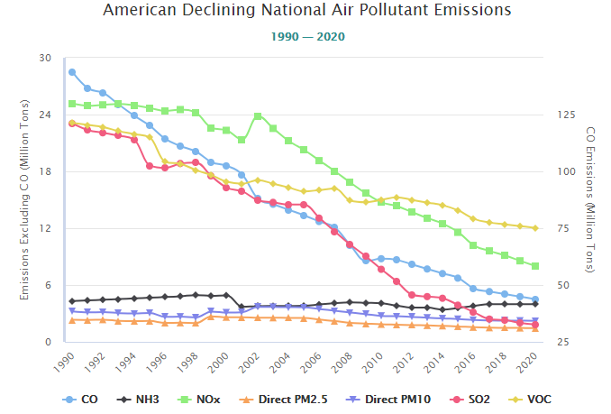
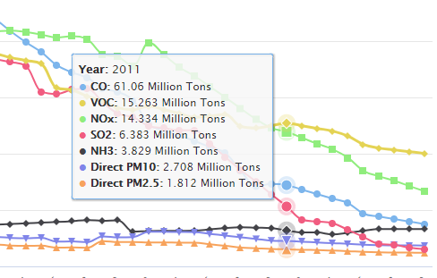
TASK 1
Plot 1: American declining nationall air pollutant emissions
Task: to find the output trend of CO, NH3, NOx, Direct PM2.5, Direct PM10, S02, VOC through 1990 to 2020.
Quantitative attribute
Trend: Emissions of key air pollutants continue to decline from 1990 levels:
CO: decrease 70%
NH3: decrease 8%
NOx: decrease 68%
PM2.5: decrease 38%
PM10: decrease 31%
SO2: decrease 92%
VOC: decrease 48%
Tendency: all decline
Data: 3 Quantitative attributes
1 categorical attribute
Mask:
Points
Line connects marks between them
Channels:
Aligned lengths to express quantitative value
Separated and ordered by key attribute into horizontal regions
Quantitative attribute
Quantitative attribute

Slide 6
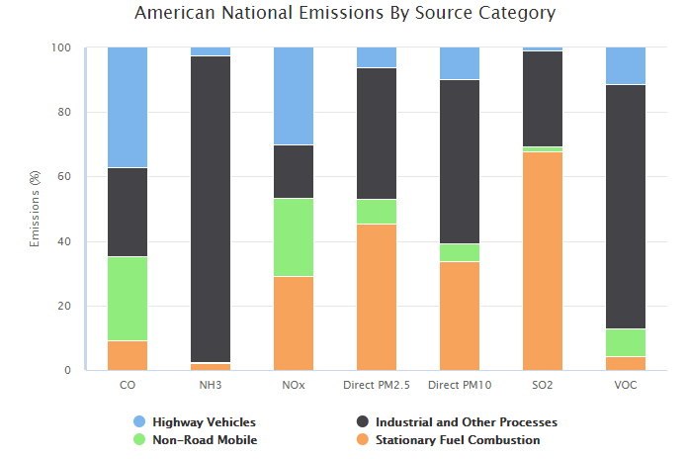
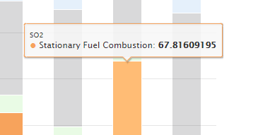
Plot 2: American national emissions by source category
As the chart shows, pollutants are emitted by a variety of sources.
Data: 2 Categorical attributes
1 quantitative attribute
Categorical attribute
Quantitative attribute
Task: Find the category of national emissions and is percentage.
Categorical attribute
Mark:
Line marks normalized to full vertical height;
Single stacked bar equivalent to full pie
highway vehicles, like car,…
industrial and other processes, like: metal smelters, petroleum refineries, cement kilns and dry cleaners…
non-road mobile sources, like: marine vessels, aircraft and locomotives…
fuel combustion sources, like: electric utilities, industrial boilers…
Channels:
Length and color
Spatial regions: one per glyph

Slide 7
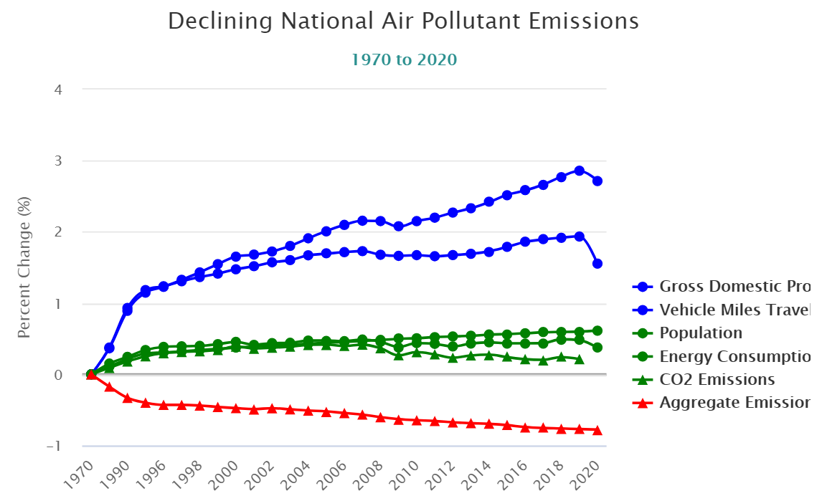
Variable introduction
Task 2
Comparison for Growth Areas and Declining Emissions
Year
The time when the value is record
GDP
Change rate of Gross Domestic Product
comparing to 1970
Multi-line chart for Comparison
AggregateEmissions
Change rate of the aggregate emissions,
which contain PM2.5, PM10, SO2, NOx, VOCs,
CO and Pb
Shape: type of data
EnergyConsumption
Change rate of the energy consumption
Color: trend type
CO2Emssions
Change rate of CO2 emissions
VehicleTraveled
Change rate of the Vehicles Miles Traveled
Population
Change rate of population comparing to 1970

Slide 8
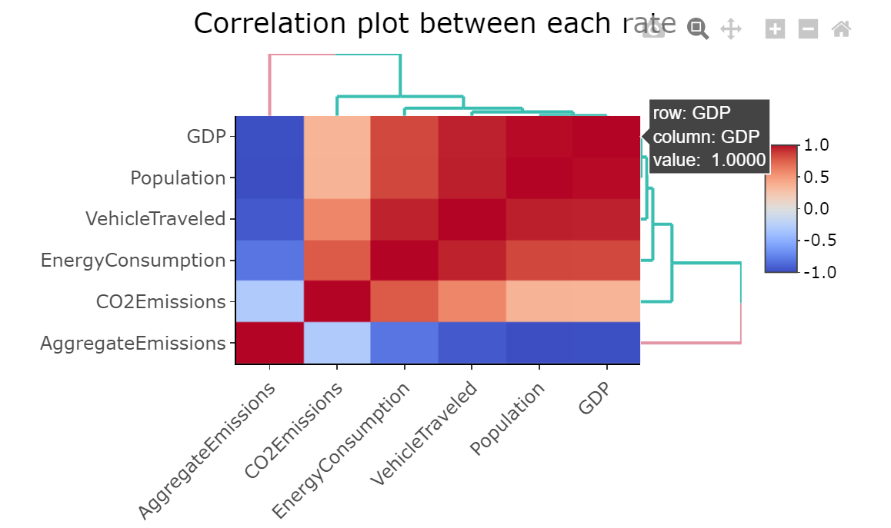
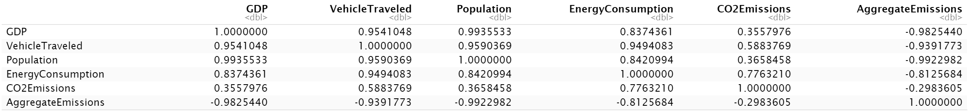
Graph composition
Data
2 categorical, 1 quantitative
Task
Relationship analysis
Mark
Area
Channel
Color hue
Number
Color
Cooler shade: negative
Warmer shade: positive

Slide 9

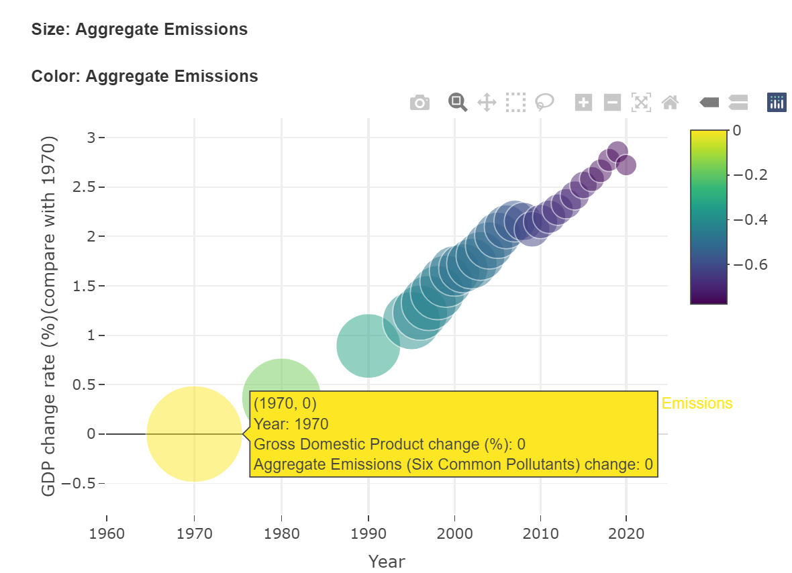

Relationship
Graph composition
Data
3 quantitative
Task
Relationship analysis
Mark
Point
Select for detail
Channels
Horizontal, Vertical Positions,
Area, Color hue
Y: GDP
Size and color: Aggregate Emissions
Economic development helps reduce Emissions

Slide 10
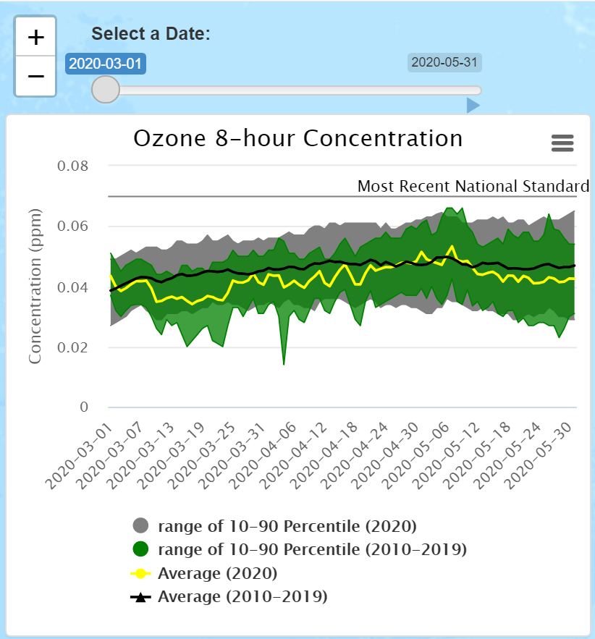
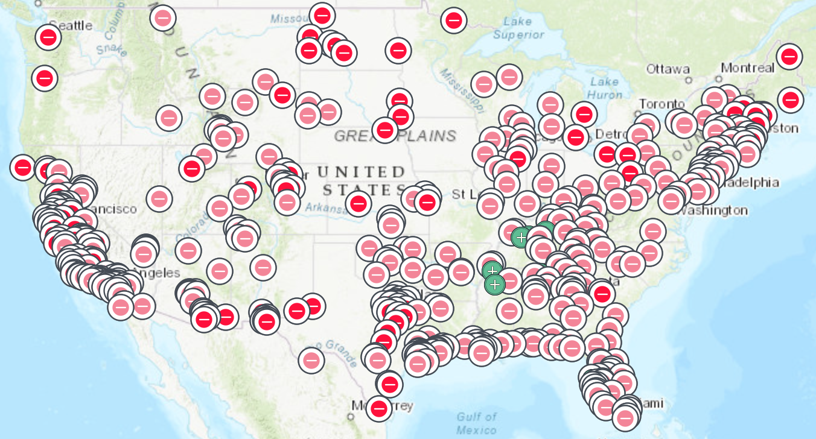




Task 3: Impacts From The COVID-19 Restrictions
Time control line
Variable Introduction
start or pause
Ozone 8-hour Concentration (mm)
Daily max-8 hours Ozone Concentration
Date
94 days From 2020-3-1 to 2020-5-31
concentration <= 0.04
Area range
0.041 < concentration <= 0.054
0.055 < concentration <= 0.07
concentration > 0.071

Slide 11
Task 3: Impacts From The COVID-19 Restrictions
Time control line
Graph composition
start or pause
Data
4 quantitative, 1 categorical
Task
Comparison
Mark
Points
Area range
Channels
Icon, Color Hue,
Geograohic Positions

Slide 12
Task 3: Impacts From The COVID-19 Restrictions
Same time range
Graph composition
Data
8 quantitative
Task
Comparison
Mark
Points
Line connects marks between them
Area range
Channels
Area range, Color

Slide 13
01
Demo
02
Provide constructive suggestions with visual support for Chinese Air Quality and Pollution problem
Conclusion

Slide 14
THANK YOU !
Group 9

Slide 15
Reference
T. Munzner, ”A Nested Model for Visualization Design and Validation,” IEEE Transactions on Visualization and Computer Graphics, vol. 15, no. 6, pp. 921-928, 2009.
Du, Z., Fang, L., Bai, Y., Zhang, F., & Liu, R. (2015). Spatio-temporal visualization of air–sea CO2 flux and carbon budget using volume rendering. Computers & Geosciences, 77, 77-86. https://doi.org/10.1016/j.cageo.2015.01.004
Liu, D., Peng, J., Wang, Y., Huang, M., He, Q., Yan, Y., Ma, B., Yue, C., & Xie, Y. (2019). Implementation of interactive three-dimensional visualization of air pollutants using WebGL. Environmental Modelling & Software : With Environment Data News, 114, 188-194. https://doi.org/10.1016/j.envsoft.2019.01.019

